Slide 1
Final Project
Course: Python For Business Analytics ECON 32500
By: Edy Morales, Najia Sultana, Anthony Nghe

Slide 2
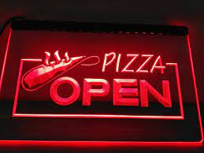
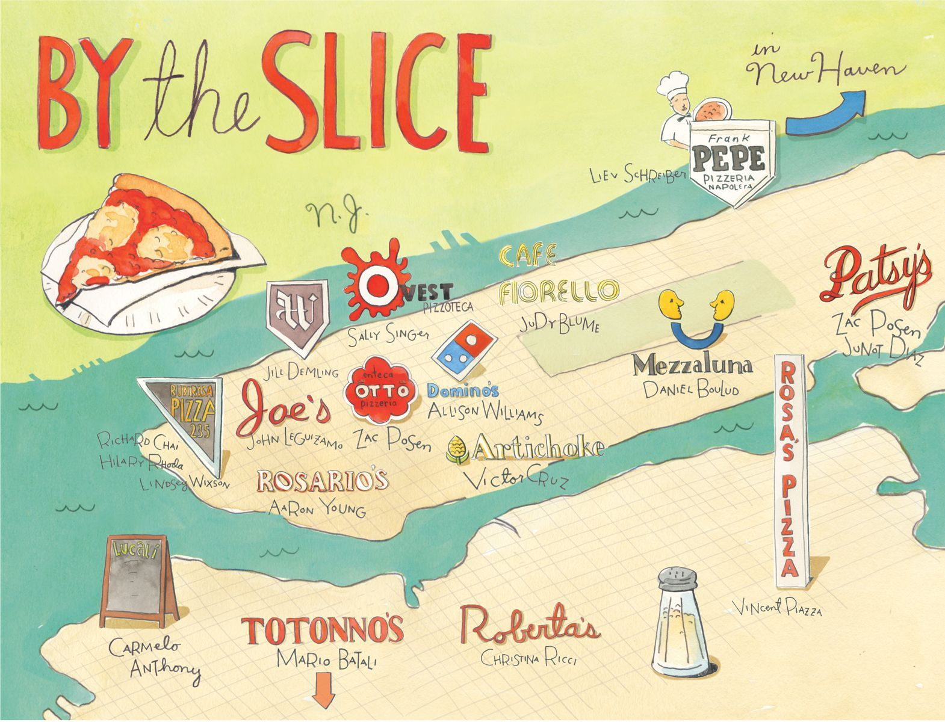
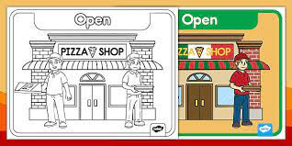
Introduction
Opening up a pizza business in the City of New York can be very competitive. Our business has to keep up with our competition in order to stay successful for the coming years. New York is well known for their pizza, so we have to keep up to that standard. That’s why our business will be offering many types of options from whole pies to single slices. As well as offering a variety of toppings to the pizza. We have to analyze all that data we start off with and start making decisions to help increase the success of our business.

Slide 3
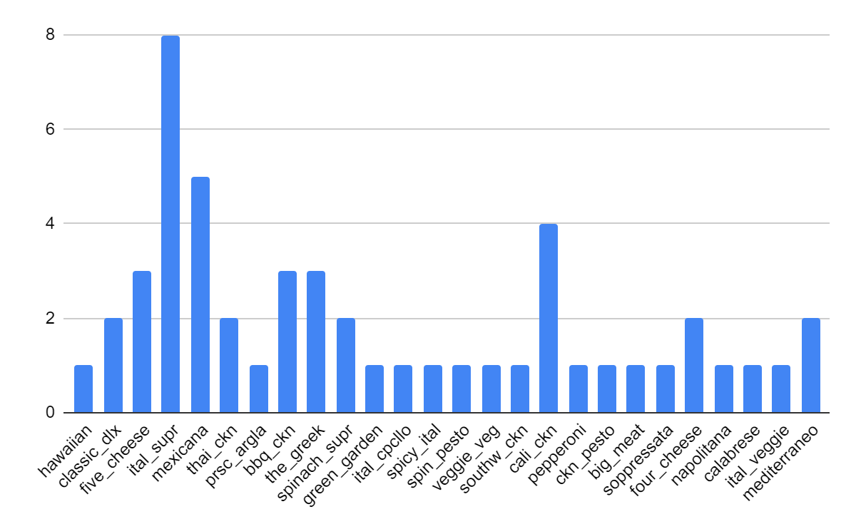
Business Opportunity One
A way to increase profit for the business is eliminating unpopular pizza toppings.
Having the least ordered items on the menu reduces profit in the long run.
Saves the business money from wasting on ingredients that aren’t going to be used.

Slide 4
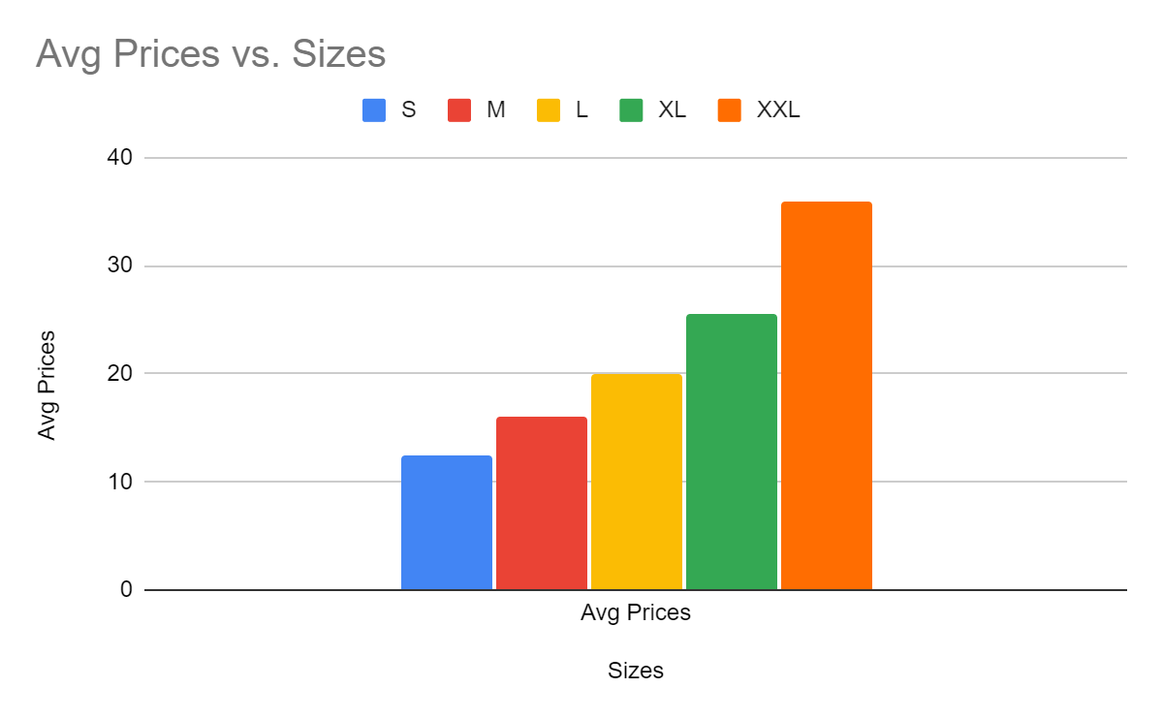
Pizza sizes and prices
Prices should be kept the same as competitors have higher prices in NYC.
The lower price will attract more customers, and steal customers from other businesses.
An average price for a pie in NYC is around $20-$30 for a Large.

Slide 5
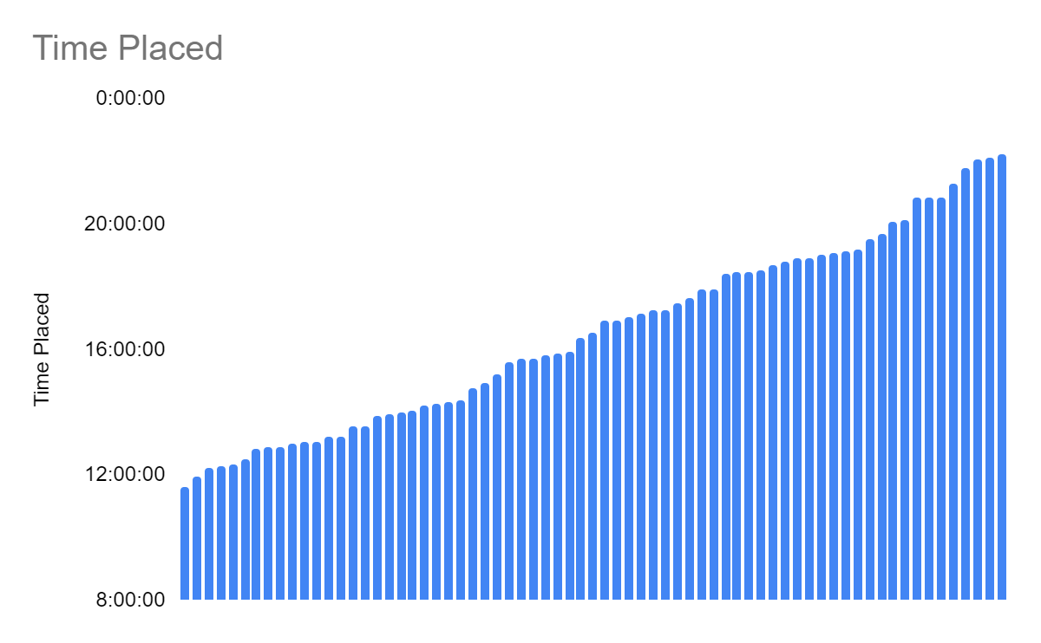
Business Hours
Have the restaurant open at a specific time so money isn’t lost.
Optimal time of operations is 11-10.
Having the restaurant operate from 11-9 would save the restaurant from paying employees if the hour 9-10 isn’t busy.

Slide 6
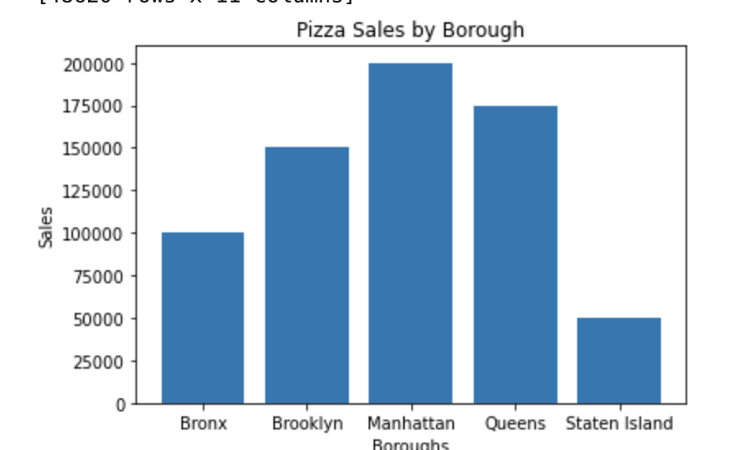
Location Decision Made From Datas
- The best borough to open pizzerias are Brooklyn, Manhattan, and Queens.
- These three boroughs have high demands in pizza purchases from customers.
- Increase sales

Slide 7
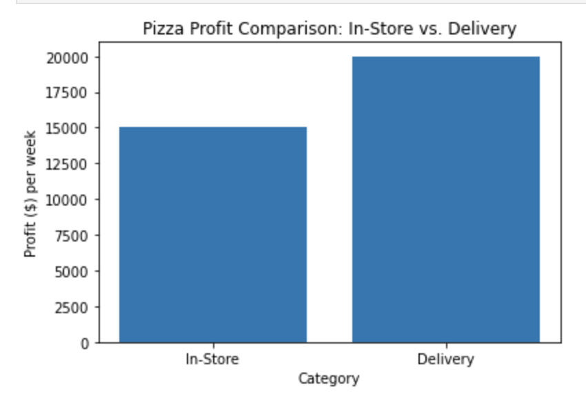
In-store vs. Delivery
From these graphs, it’s best to focus more on delivery because more customers are getting their pizza through delivery compare to in-store purchases.
In addition, there are higher potential
tipping from delivering pizza to
customers.
It would be wise to buy a bike or some
sort of vehicles to deliver pizza.

Slide 8
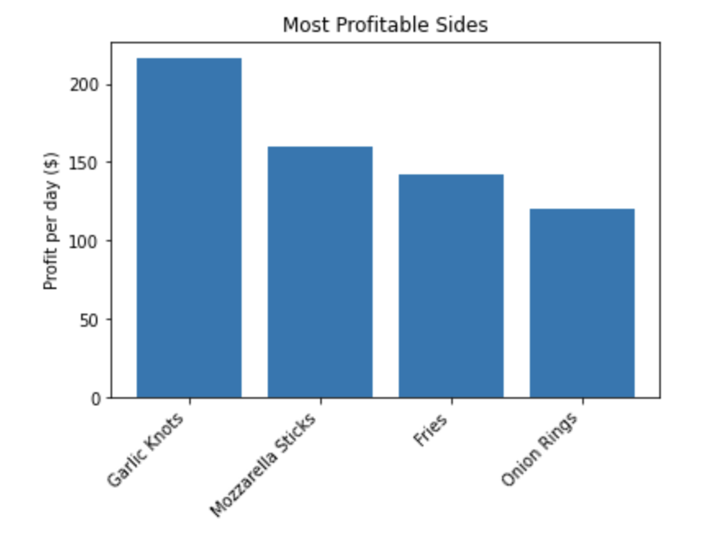
Most Profitable Slides
- The most profitable sides are garlic knots, mozzarella sticks, fries, onion rings
- The pizzeria can focus on getting ingredients for these sides, and not other ingredients because money resources can be wasted if spent on unnecessary materials
- The restaurant can focus on making these sides along with the popular pizza. Increased productivity.

Slide 9
Conclusion
Through our data and analytical process we have presented different options for the businessowners to improve their business. These datas have been separated through several criterias and their opportunities to improve to stay on the business and for better outcomes.

